Slide 1

Review Ratings for Denver airbnb Listings
Python data cleansing and graphing
exercise

Slide 2

Team Members
Basic Pumpkin Spice
Jaspreet Nanda
Jacob Schneider
Megan McGovern
Olivia Nicholson
Tim Cole

Slide 3

Table of Contents
Overview
Problems to solve
Jupyter Notebook
Market trends
Neighborhood
Amenities
Property Type
Hosts

Slide 4
Overview
Leveraging Airbnb data from insideairbnb.com for the city of Denver, our team reviewed factors of a listing that might impact a review score. We read our dataset into a Python Jupyter Notebook to cleanse the data, and analyzed our data in matplotlib charts to infer our observations.

Slide 5
Questions to Answer
How does the neighborhood affect a review score?
Is there a direct relationship between property types and a positive guest experience (i.e. high review score)?
1
3
2
Does a specific amenity or quantity of amenities increase overall rating for a property?
4
What host aspects can positively or negatively impact a guest’s review score?

Slide 6

Review of Super Host Jill
This was another wonderful stay with Jill. This time I had one of Jill's excellent breakfast frittata. This place makes a wonderful home away from home, whether you are visiting on business or vacation. If you have questions about if the correct location or concerns, please contact Jill. I am always amazed at what she will do to make a person stay wonderful.

Slide 7
Jupyter Notebook

Slide 8
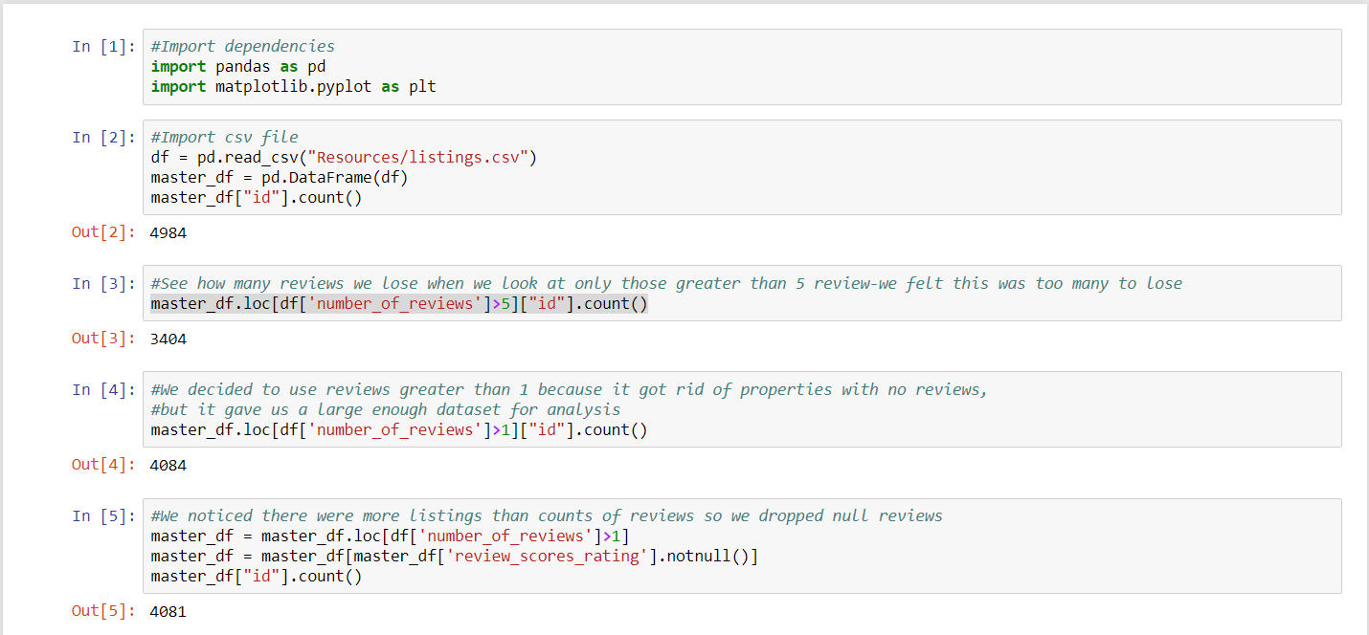
Jupyter Notebook | Data Exploration

Slide 9
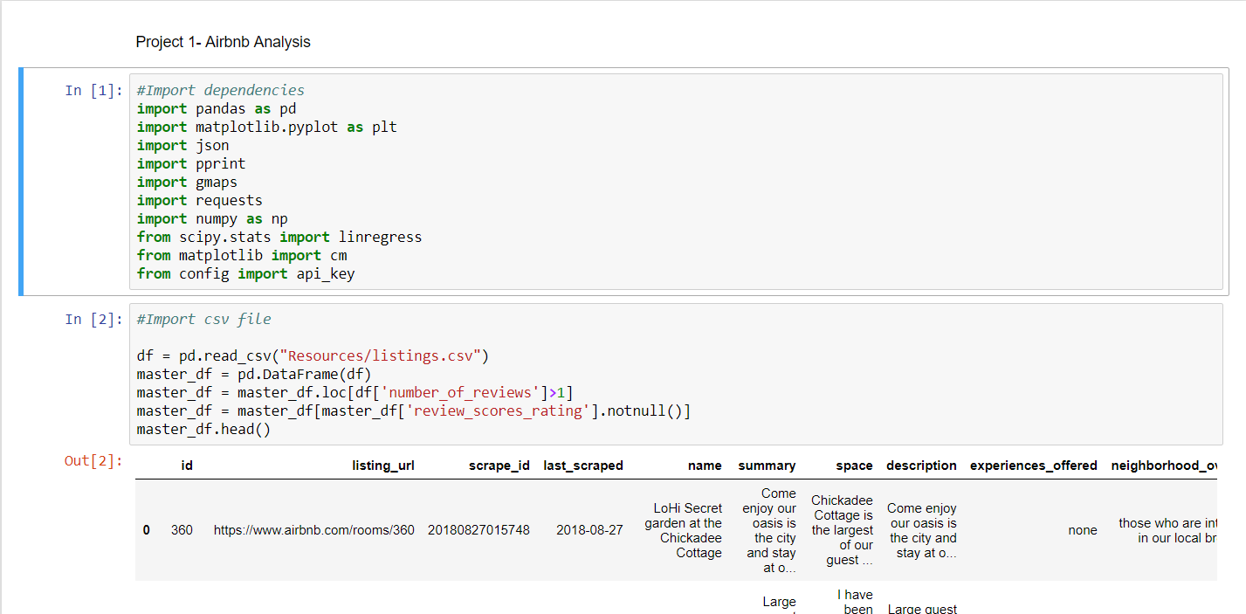
Jupyter Notebook

Slide 10
Understanding the market

Slide 11


Market trends
01 | Neighborhood
How does the neighborhood affect a review score?

Slide 12
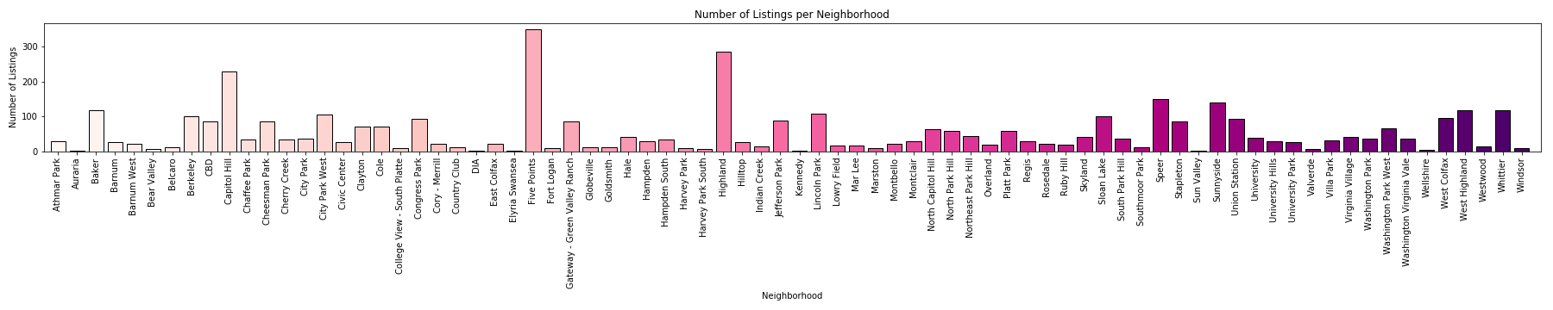
Neighborhood Density

Slide 13
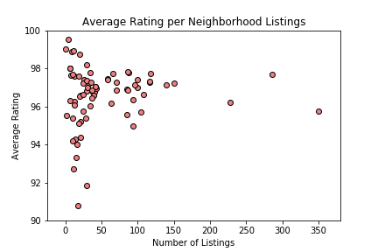
Neighborhood Ratings

Slide 14
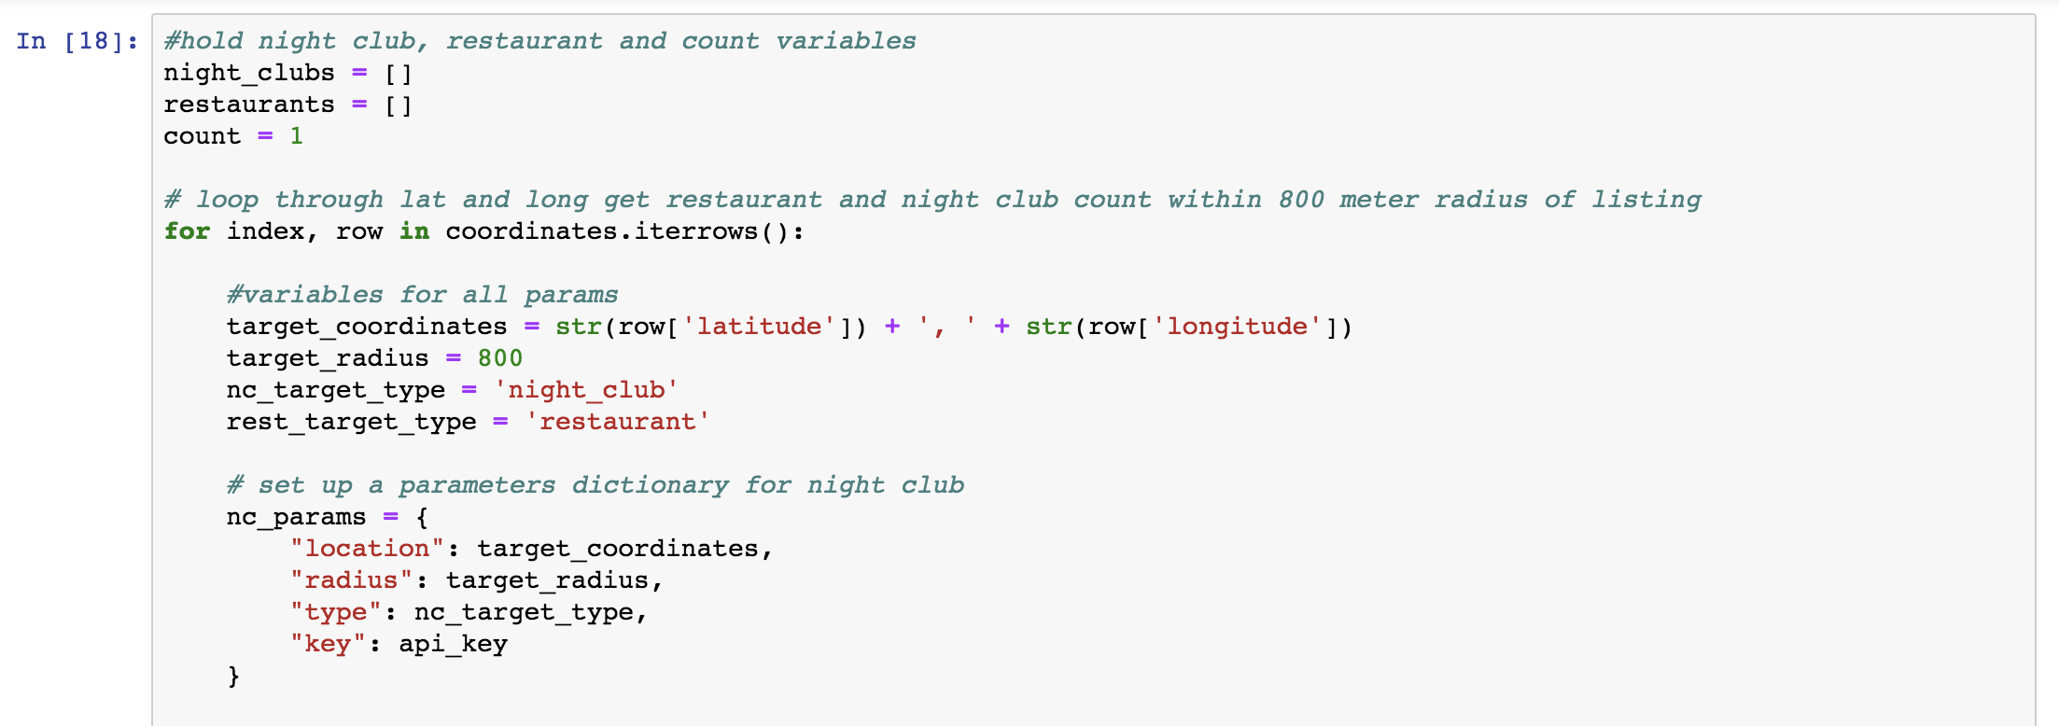
Restaurant and Nightclub Proximity
Using the Google places API to find each neighborhood’s restaurant and night club density.
Jupyter Notebook Code Snippet

Slide 15
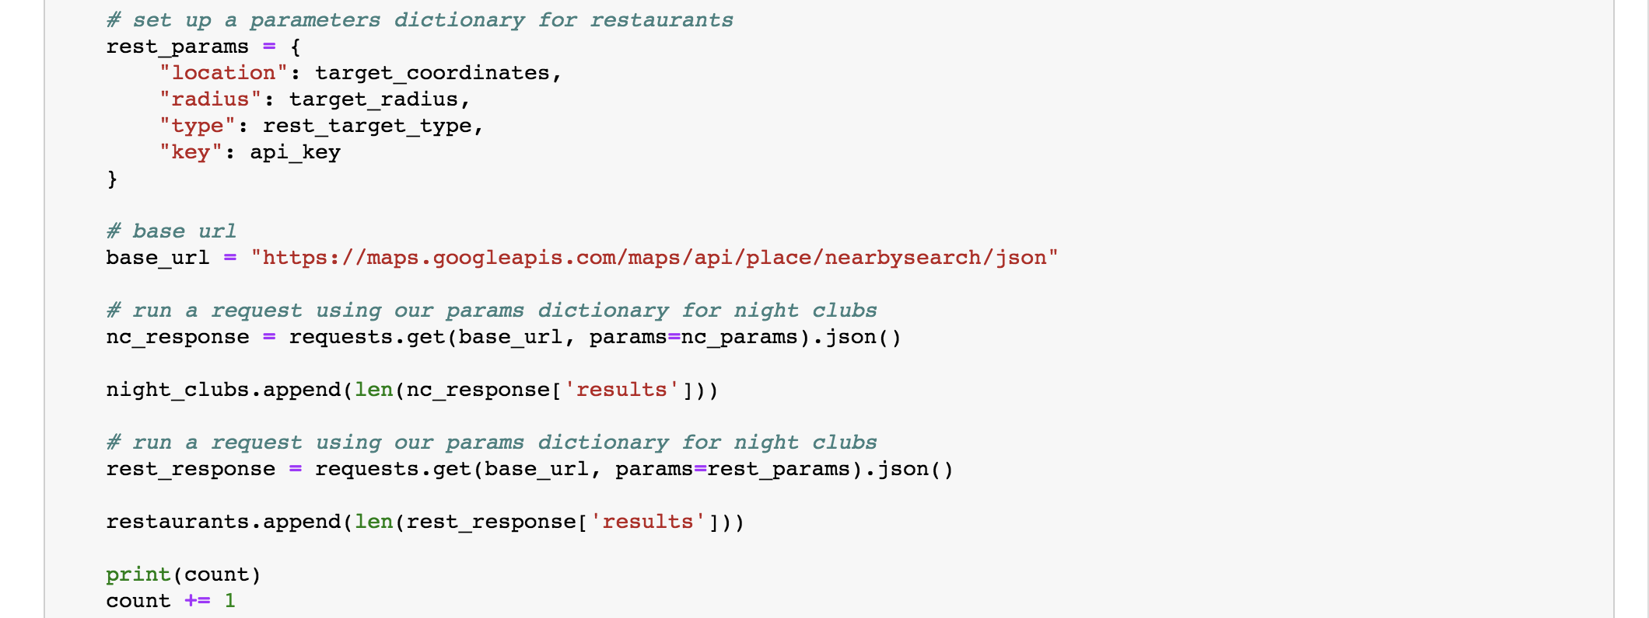
Restaurant and Nightclub Proximity
Jupyter Notebook Code Snippet

Slide 16
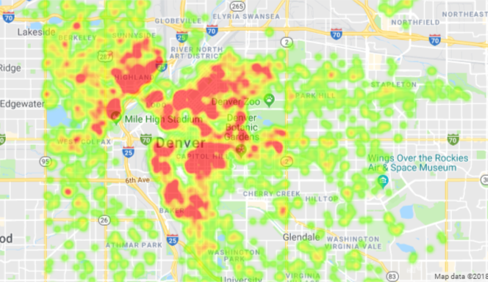
Neighborhood Listing Density

Slide 17
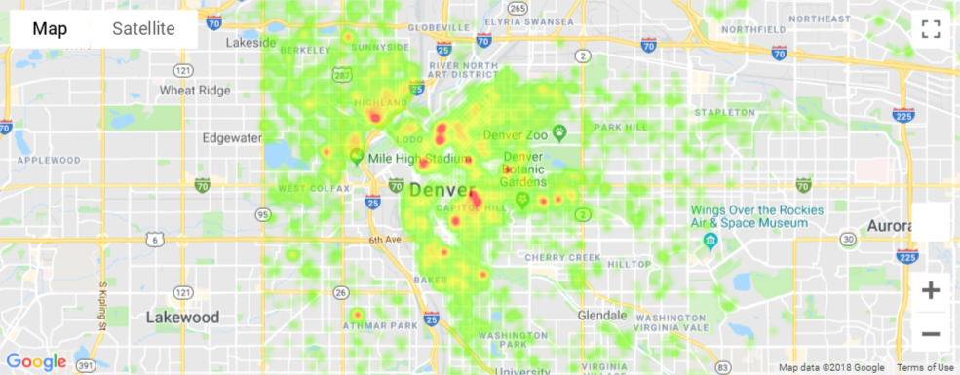
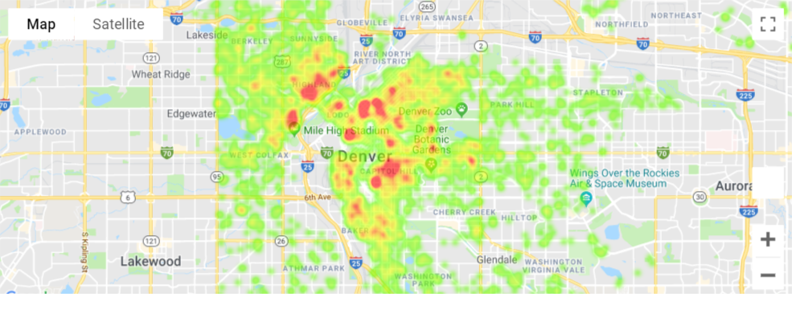
Neighborhood Restaurant and Nightclub Proximity
Restaurants within 800 Meters
Night Clubs within 800 Meters

Slide 18

Market trends
02 | Amenities
Does a specific amenity or quantity increase overall rating for a property?

Slide 19
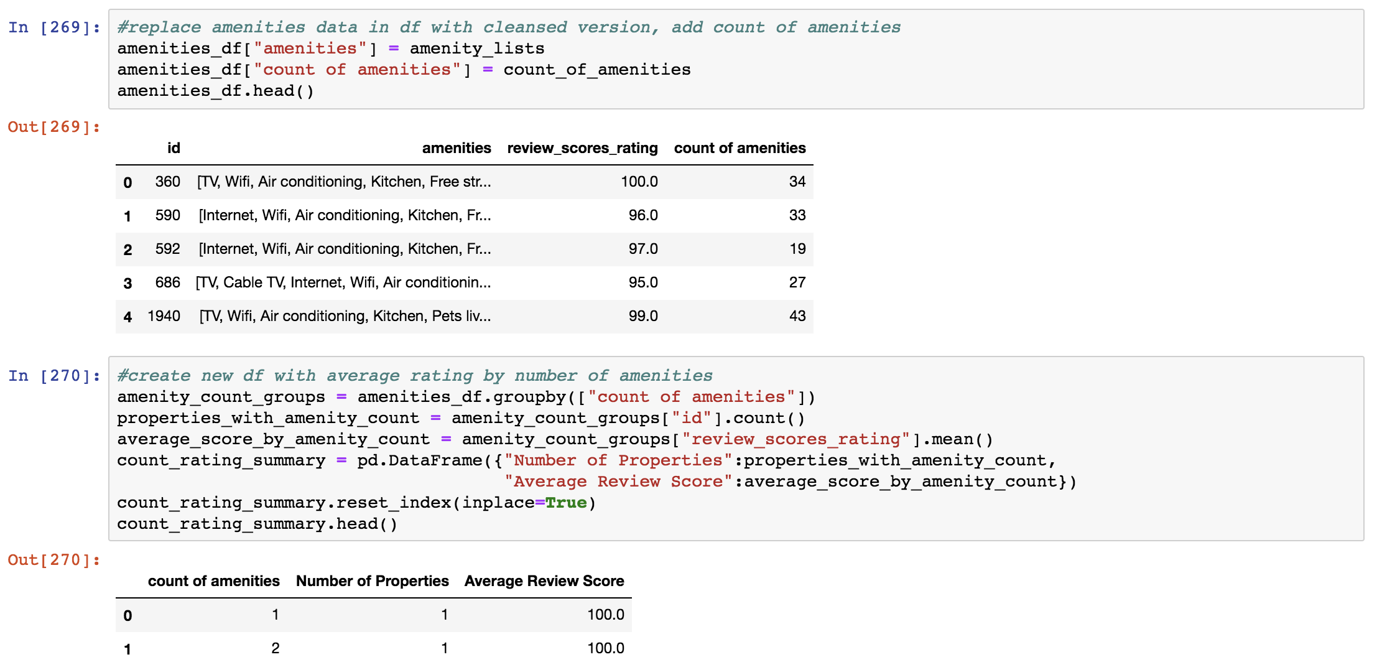
Review Score by Number of Amenities
Jupyter Notebook Code Snippet
After cleansing the amenities column into lists, create a dataframe of average review score by count of amenities.

Slide 20
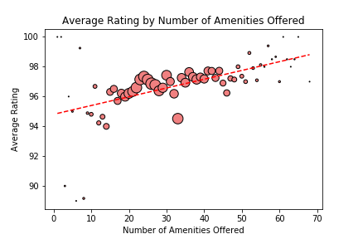
Review Score by Number of Amenities

Slide 21
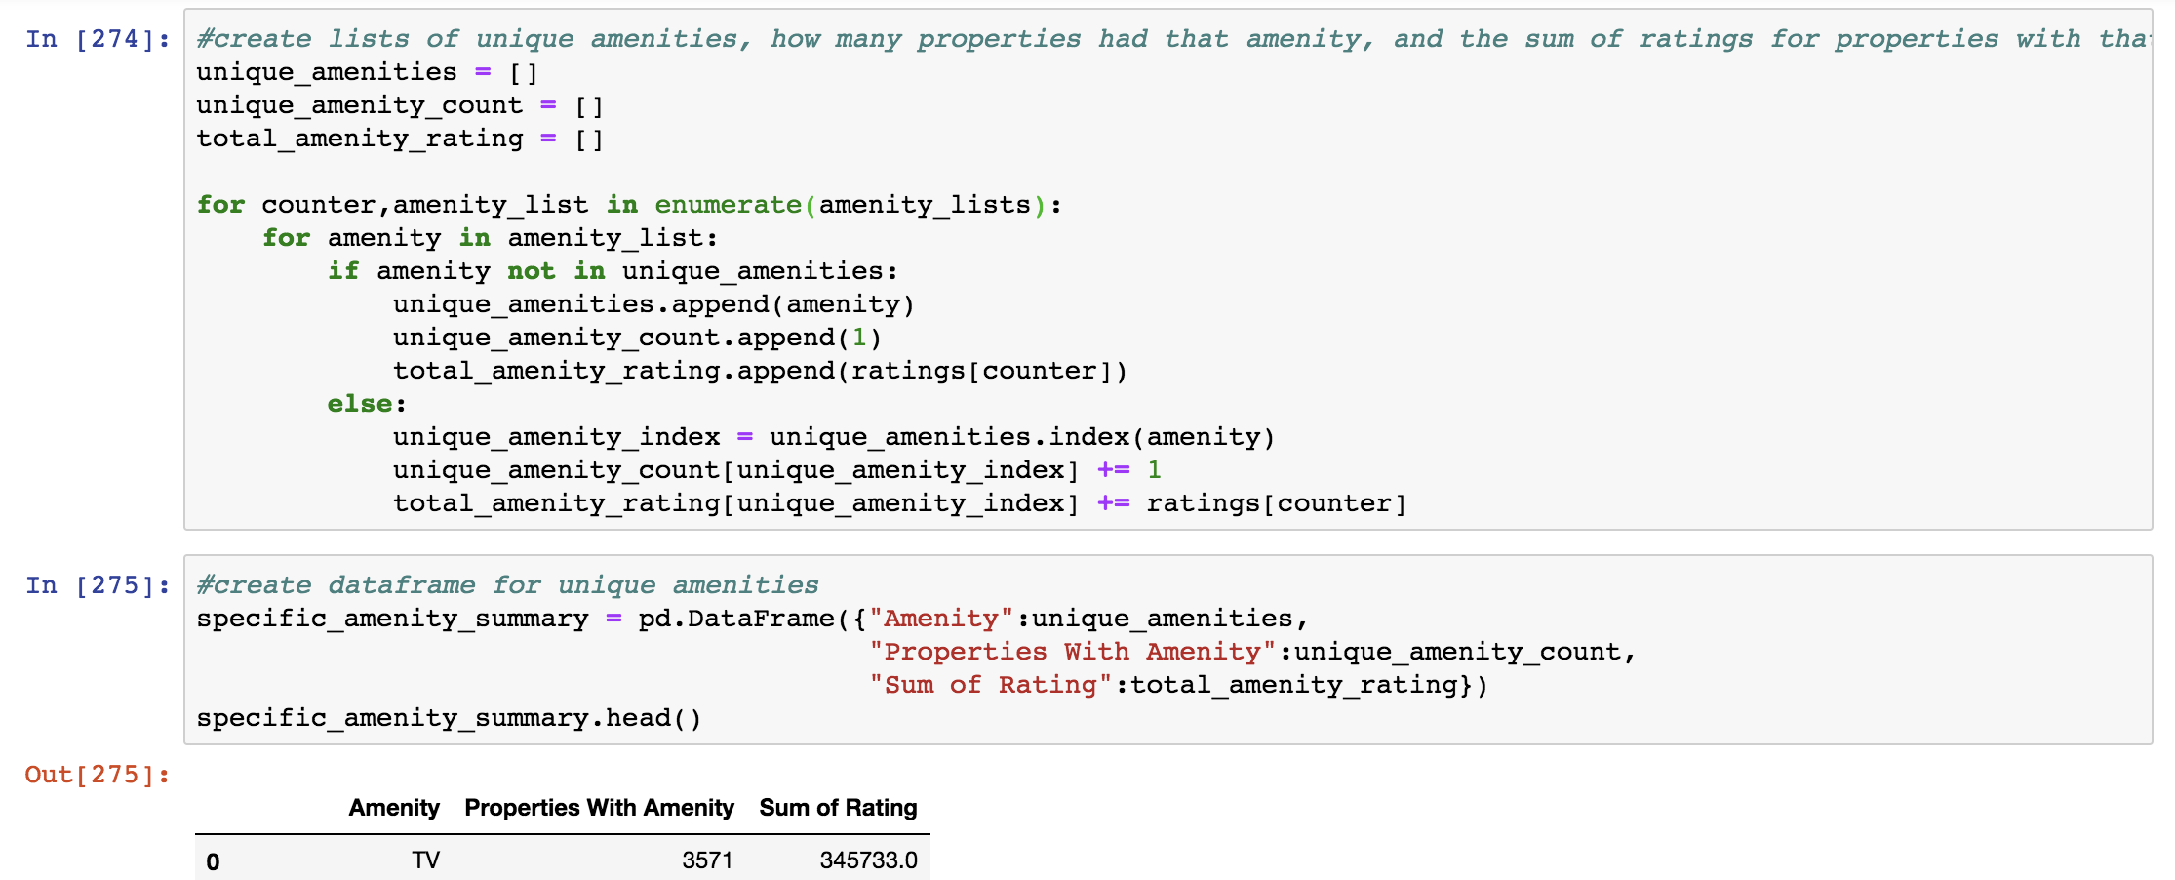
Review Score by Specific Amenities
Jupyter Notebook Code Snippet
Create a dataframe of each individual amenity, how many properties have that amenity, and what the average rating for properties with that amenity is.

Slide 22
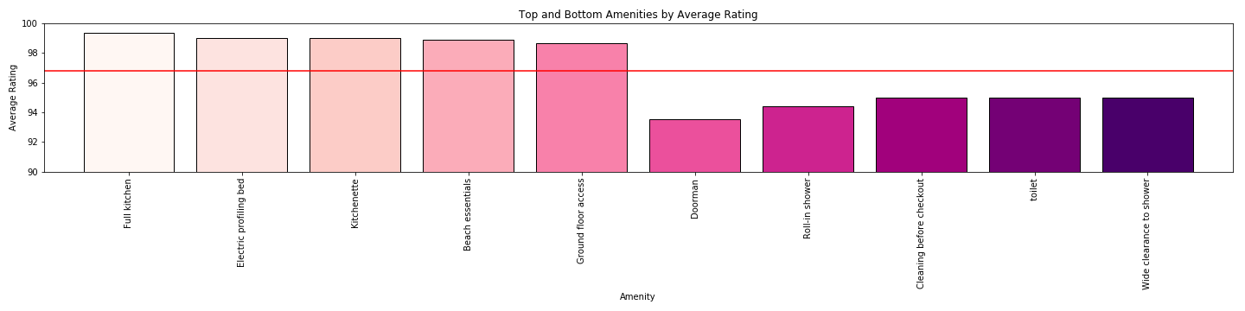
Review Score by Specific Amenities

Slide 23

Market trends
03 | Property Types
Is there a direct relationship between property types and a positive guest experience (i.e. high review score)?

Slide 24
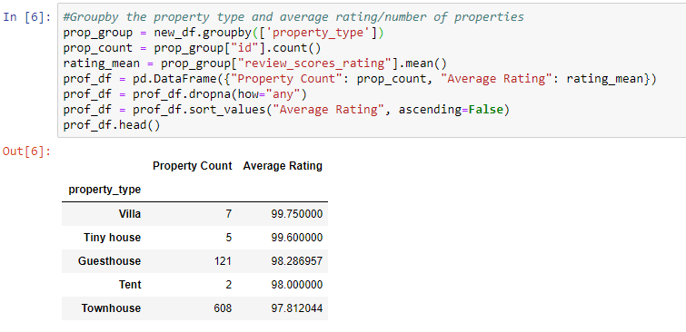
Review Score by Property Type
-Grouped by property type
-Found average rating of each property type
Jupyter Notebook Code Snippet

Slide 25
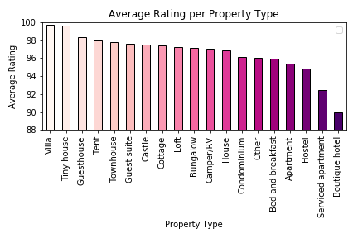
Review Score by Property Type

Slide 26
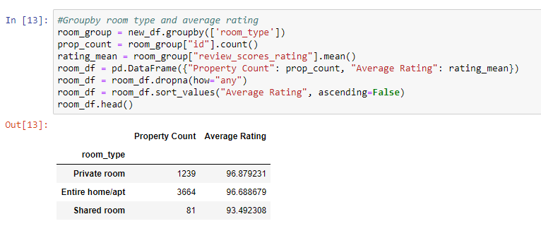
Review Score by Room Type
-Grouped by room type
-Found average rating of each room type
Jupyter Notebook Code Snippet

Slide 27
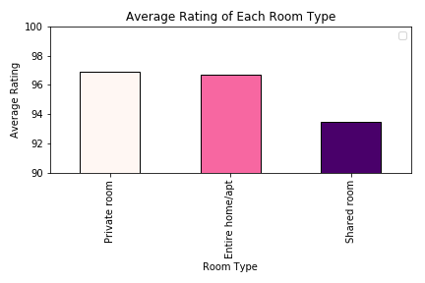
Review Score by Room Type

Slide 28
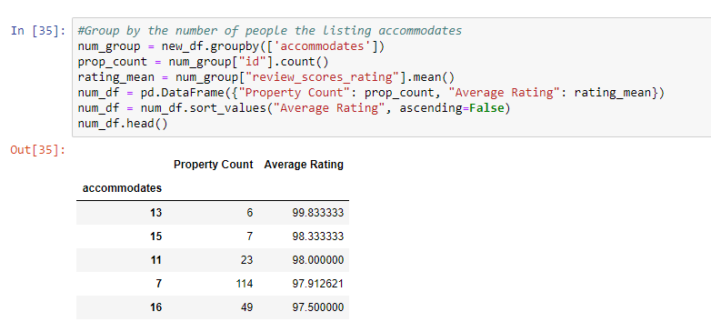
Average Rating By Number of People Listing Accommodates
-Grouped by number of people the listing accommodates
-Found average rating of each accommodation number

Slide 29
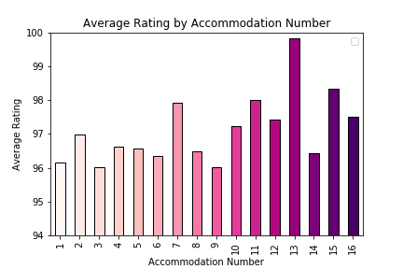
Average Rating By Number of People Listing Accommodates

Slide 30
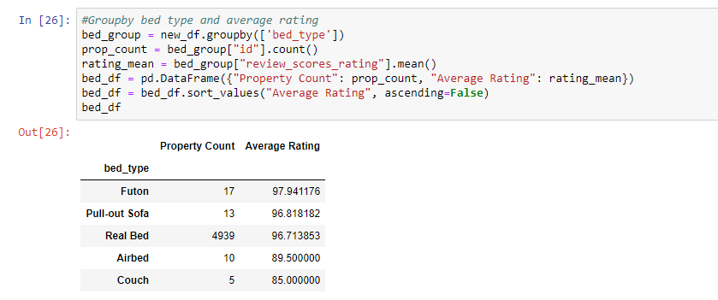
Review Score by Bed Type
-Grouped by bed type
-Found average rating of each bed type
Jupyter Notebook Code Snippet

Slide 31
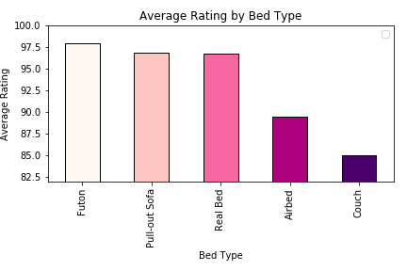
Review Score by Bed Type

Slide 32


Market trends
04 | Hosts
What host aspects can positively or negatively impact a guest’s review score?

Slide 33
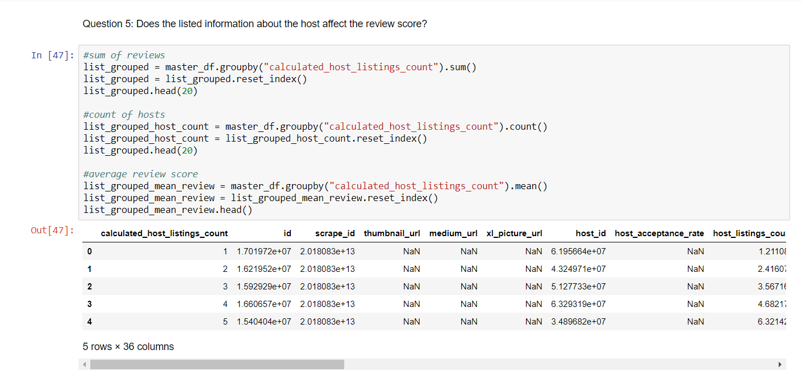
Review Score by Host Listing Count
Jupyter Notebook Code Snippet
Group the master dataframe by host listing data information:
COLUMNS:
“calculated_host_listings_count” “cancellation_policy” “is_business_travel_ready” “host_is_superhost”

Slide 34
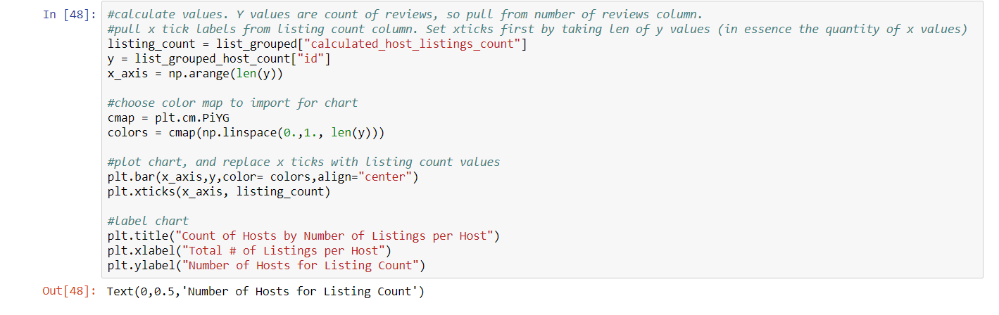
Review Score by Host Listing Count
Jupyter Notebook Code Snippet

Slide 35
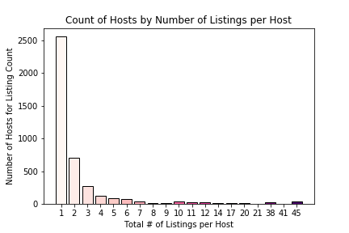
Review Score by Host Listing Count

Slide 36
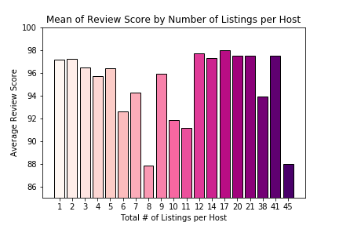
Review Score by Host Listing Count

Slide 37
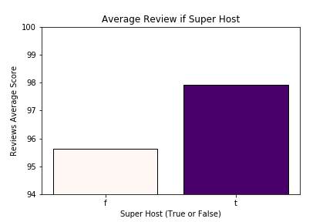
Review Score by Superhost status

Slide 38
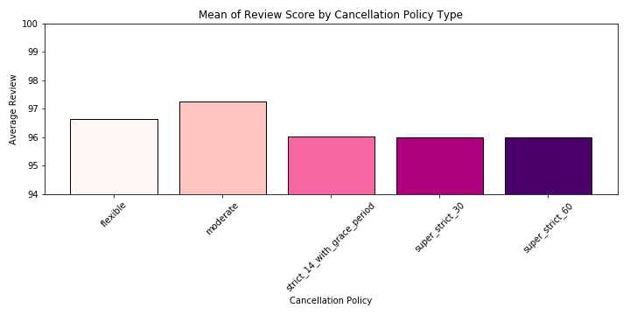
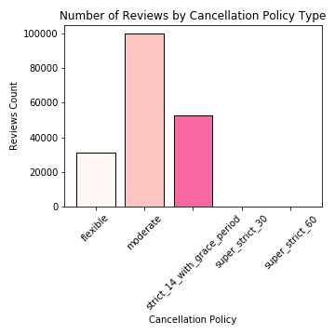
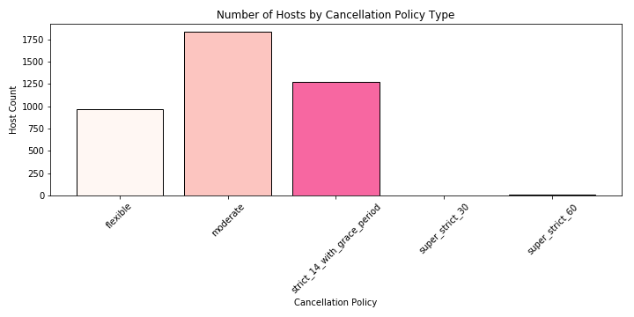
Review Score by Cancellation Policy

Slide 39
Discussion
We found that there were not any noteable correlations between Airbnb review scores and specific listing characteristics
We were surprised that there were no overwhelming trends that indicated any attributes had an impact on review scores
For example, we expected to find that certain neighborhoods had higher ratings; however, that was not the case
In general, ratings did not often vary outside the 90-100 range

Slide 40
Post Mortem
If we had more time and resources, we would have liked to expand our scope to include more cities and economic impact
One difficulty we faced was that most ratings were in the 90-100 range which made it difficult to parse out trends
We also had a sizable number of listings with no reviews which meant we had to use an even smaller data set
We were also limited on additional data needed to indicate Airbnb success (occupancy rate, earnings, costs, etc.)

Slide 41
Thank you.

